Slide 1





Slide 2
Whats the Game about?
It‘s all about winning! Always!!

Slide 3

Seriously
Whoever explodes loses
Who doesn’t explode, wins
All other cards reduce the chance to explode by exploding kittens.
Explode by pulling an exploding kittens
Survive by luck and defuse cards
Other Cards:
look into the future
suspend a turn
attack fellow players
draw from the bottom
steal cards from an opponent
reshuffle
...

Slide 4
Git and Github
Create a git project
Publish your code on Github
Connect all team members to it
Clone it to other members
Push and Pull from all members

Slide 5
Write Tests
Take the Classes from your domain model
Start developing them in Scala
Use Behaviour Driven Development
Use ScalaTest
Write a Spec using WordSpec
Use the IDEA ScalaTest Runner
Achieve 100% code coverage. And maintain it!
//Test ordner im Projekt zeigen,

Slide 6
Text User Interface

Slide 7
Take Card
def processInputLine(): Unit = { while (controller.flag == true) { println("Your turn " + controller.gameState.players(controller.gameState.currentPlayer).name) println(controller.gameState.players(controller.gameState.currentPlayer).handCards.toString()) val input = readLine() input match { case "t" => { if(controller.gameState.deck.head.cardName == "Exploding Kitten") { println("You have drawn a Exploding Kitten") println("Choose a place to put it into the deck!") context.setStrategy(new TakeExploding(readLine().toInt)) context.executeStrategy(controller) context.setStrategy(new NextPlayer()) context.executeStrategy(controller) } else { // Take a Card context.setStrategy(new TakeCard()) context.executeStrategy(controller) // Next Player context.setStrategy(new NextPlayer()) context.executeStrategy(controller) } }

Slide 8
Play Card
case "p" => // Play a Card println("Which Card do you want to play ? Please enter the Number of the Card") val input = readLine().toInt val cardType = controller.gameState.players(controller.gameState.currentPlayer).handCards(input).actionCode cardType match { case 1 => context.setStrategy(new DrawFromTheBottom(input)) context.executeStrategy(controller) case 2 => context.setStrategy(new SeeTheFuture(input)) context.executeStrategy(controller) case 3 => context.setStrategy(new Skip(input)) context.executeStrategy(controller) case 4 => context.setStrategy(new Attack(input)) case 5 => println("Choose a Player to Attack") context.setStrategy(new TargetedAttack(input, readLine().toInt)) context.executeStrategy(controller) case 14 => context.setStrategy(new Shuffle(input)) context.executeStrategy(controller) }

Slide 9
Undo/Redo
case "r" => controller.redo() case "u" => controller.undo() } } } override def update: Unit = controller.gameState

Slide 10
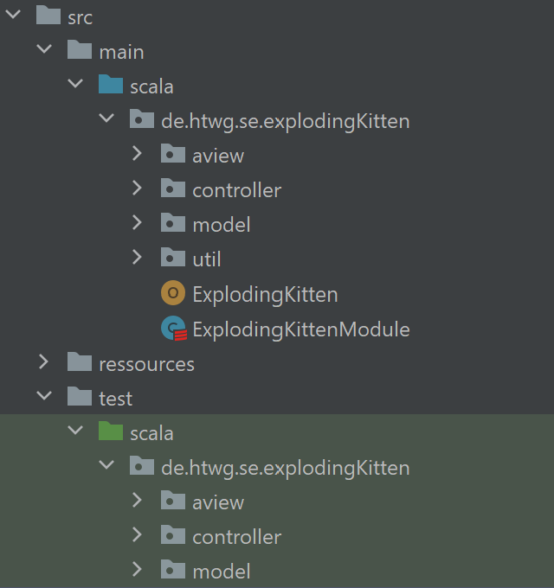
Build a MVC Architecture

Slide 11
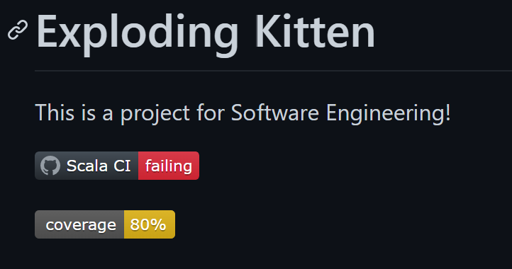
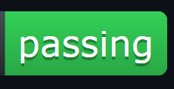
Set up a Continuous Development Process
Coverage von der website nehmen

Slide 12
Design Pattern

Slide 13
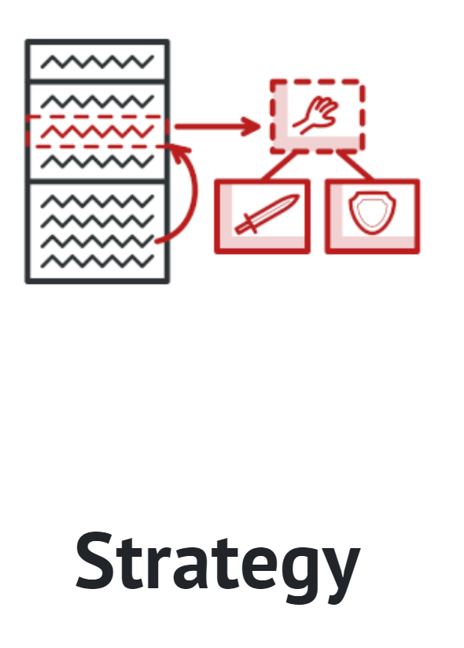
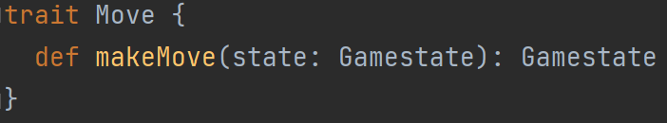
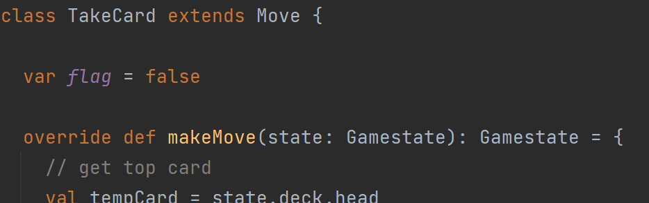
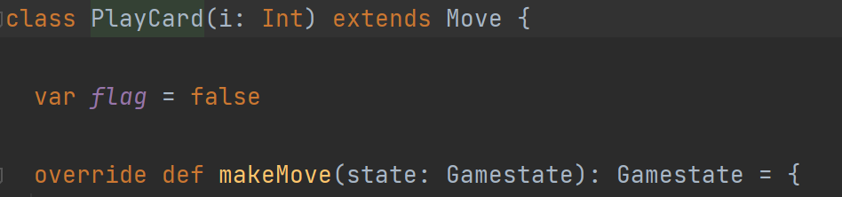
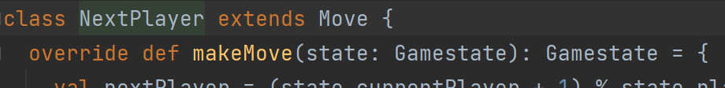
Strategy – Java Style
Context
<<interface>>
Strategy
+execute()
ConcreteStrategyA
ConcreteStrategyB
+execute()
+execute()

Slide 14
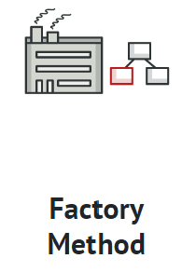
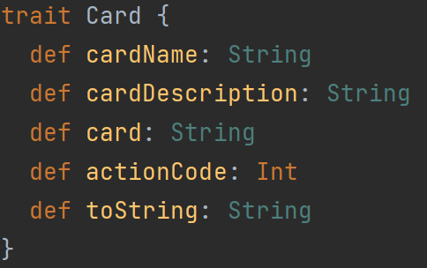
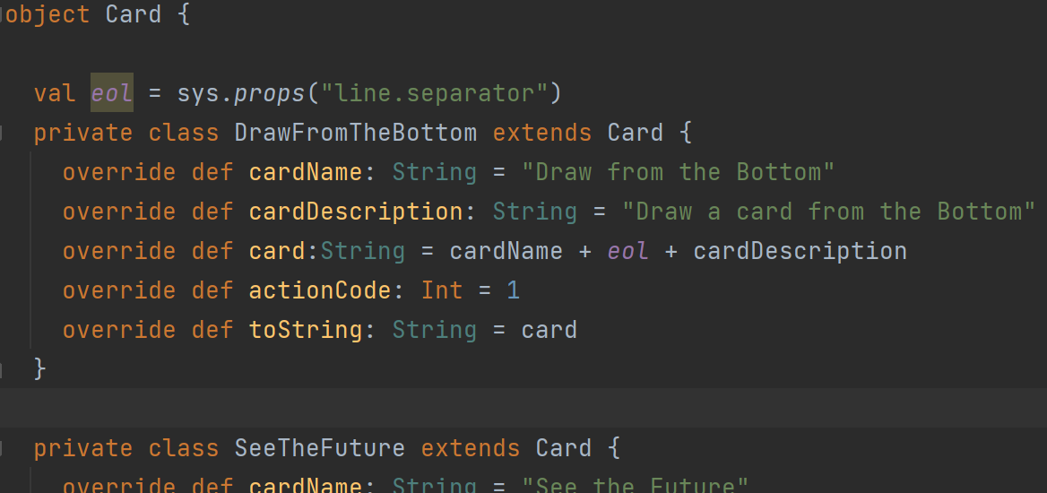
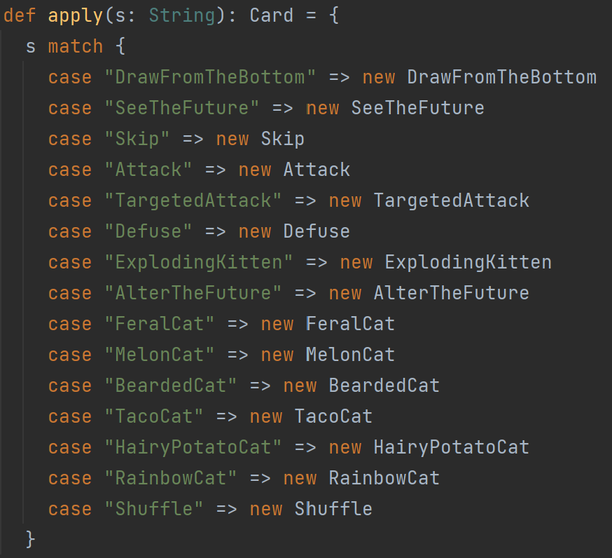
Factory
<<interface>>
Product
Creato
+factoryMethod()
+anOperation()
ConcreteCreator
ConcreteProduct
+factoryMethod()

Slide 15
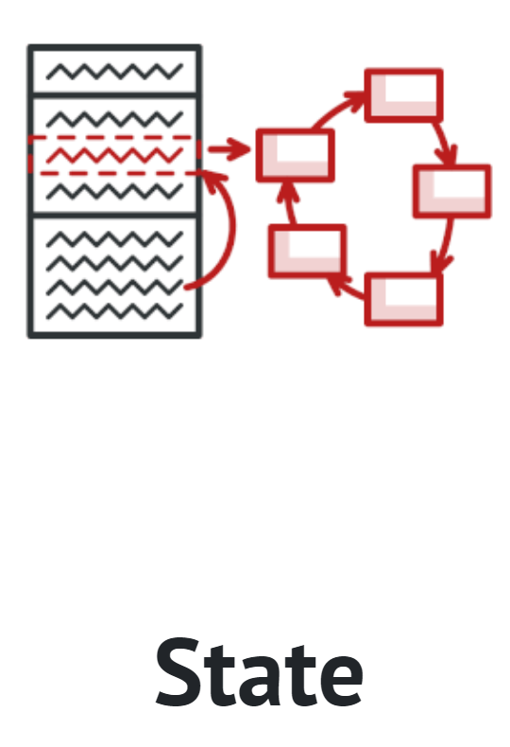
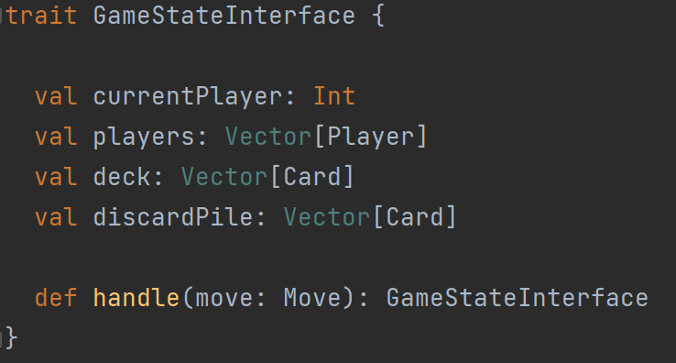
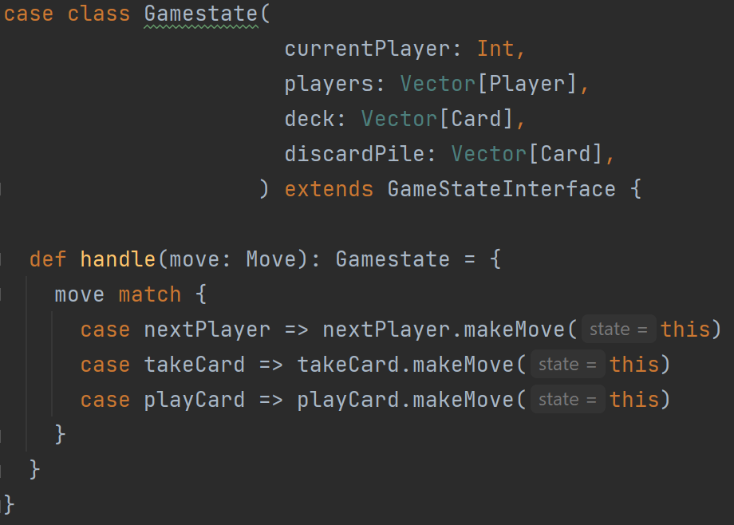
State
Context
<<interface>>
State
+request()
+handle()
ConcreteStateA
ConcreteStateB
+handle()
+handle()

Slide 16
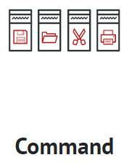
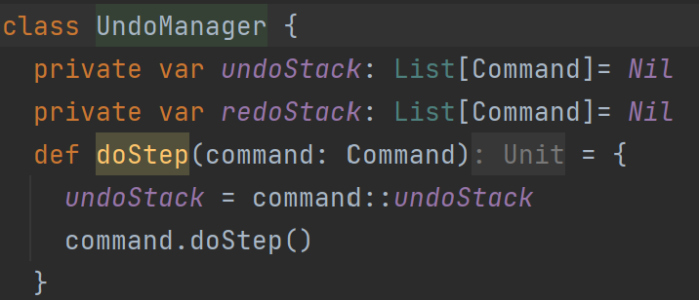
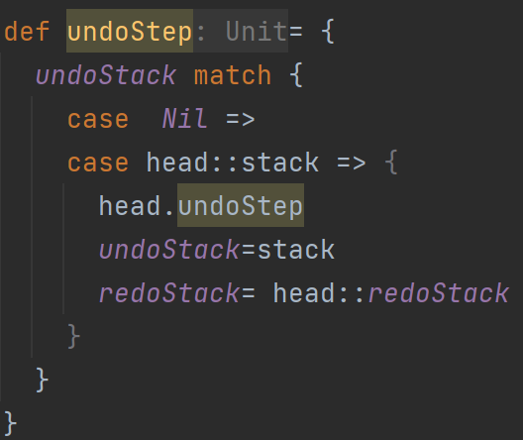
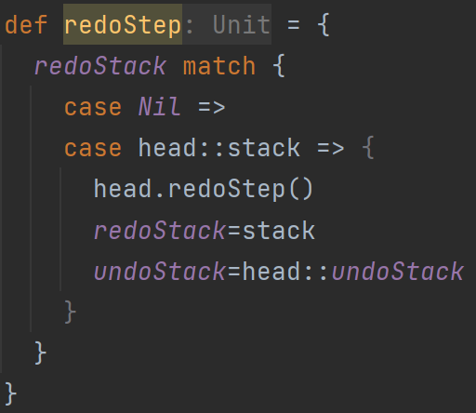
Undo
Client
Invoker
Command
+execute()
Receiver
ConcreteCommand
+execute()

Slide 17
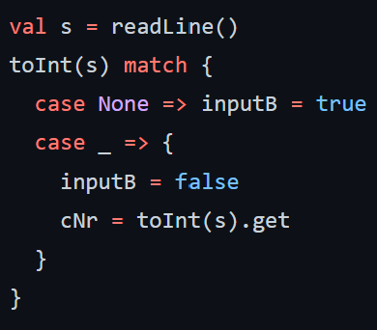
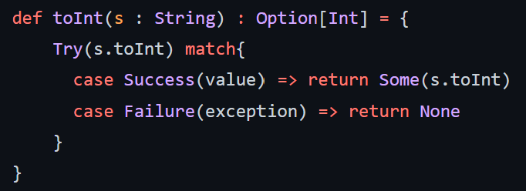
Try and Option
For testing if the input is an Integer
toInt()

Slide 18
GUI

Slide 20
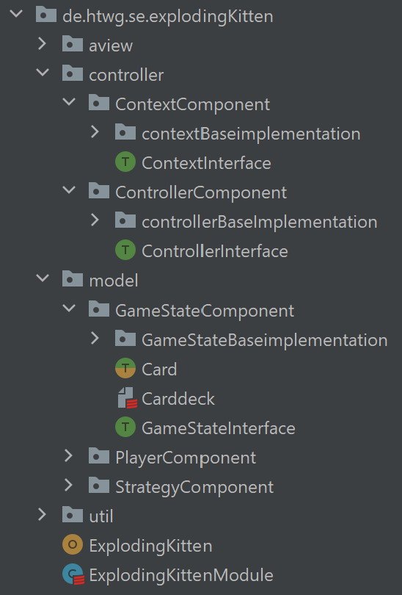
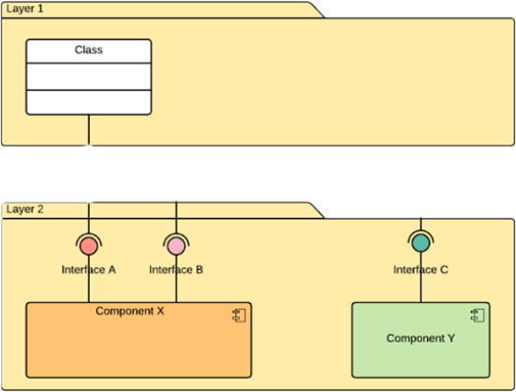
Components

Slide 21
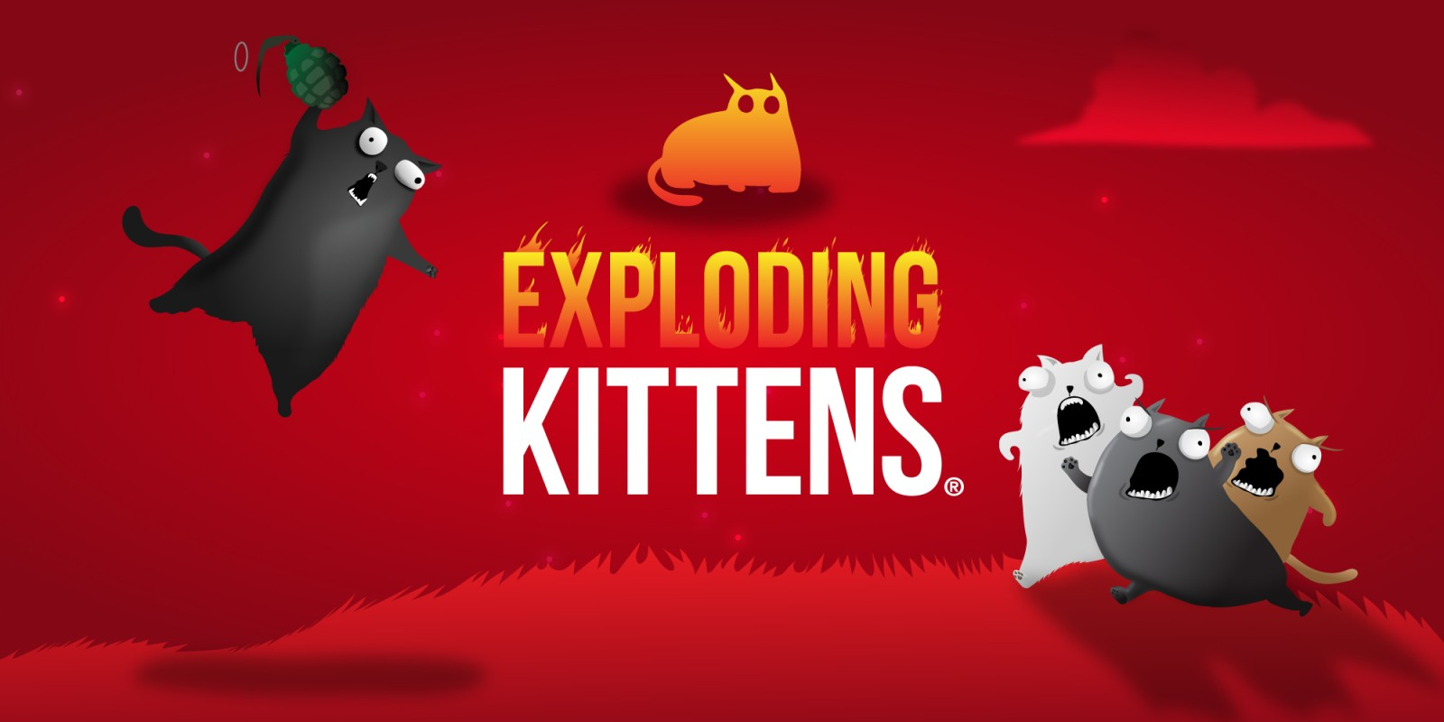
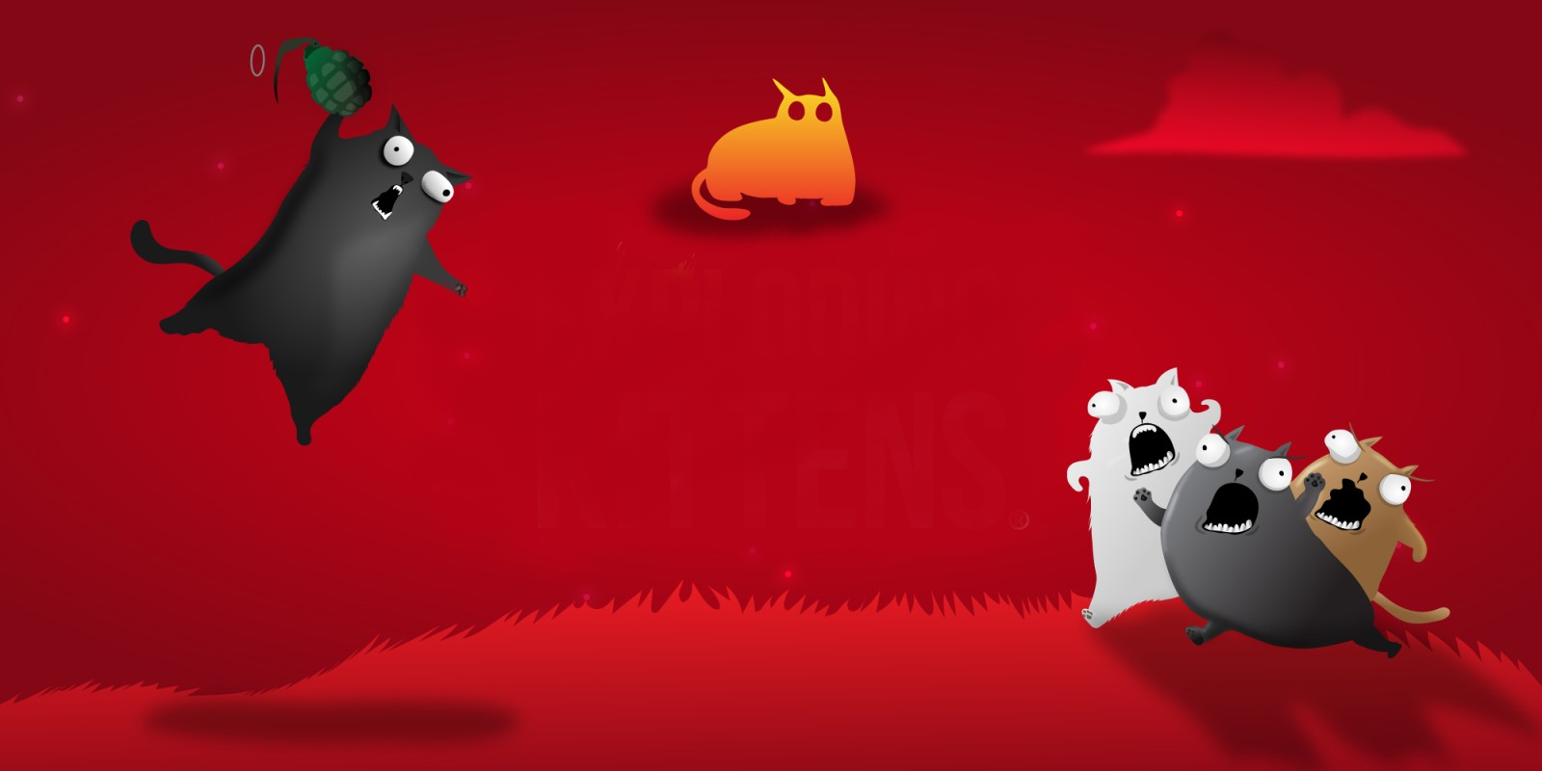
Thank you for your attention!

